Slide 1




ANANTHA LAKSHMI
INSTITUTE OF TECHNOLOGY AND SCIENCE
Approved by AICTE, New Delhi & Affiliated to J.N.T.U. Anantapur, Accredited by NAAC
Near S.K. University, Itikalapalli (V), Anantapur (Dist) Pin: 515721 A.P.
(2021-2025)
Machine Learning Techniques for Accurate Flight Delay Forecasting
BACHELOR OF TECHNOLOGY
in
DEPARTMENT OF COMPUTER SCIENCE AND ENGINEERING
Devangam Harathi 212G1A0571
Shaik Sohail 222G5A0514
Madiga Shireesha 212G1A0594
K. Kiran Kumar 212G1A0591
V. Adi Keshava Reddy 212G1A05C1
V. Pradeep Kumar Naik 212G1A05B9
Under Supervision of
Dr. K. Bhargavi M. Tech, Ph.D.,
Associate Professor & HOD,

Slide 2
CONTENTS:
ABSTRACT
INTRODUCTION
EXISTING SYSTEM
PROPOSED SYSTEM
SYSTEM DESIGN
TEST CASES
RESULTS
CONCLUSION

Slide 3
ABSTRACT:
Flight delays impact passengers, airlines, and regional economies.
A machine learning-based prediction system was developed for flight delays.
Historical flight data was used for structured predictions.
Multiple machine learning models were analyzed and compared for accuracy and efficiency.
Key insights were extracted to determine the best prediction methods.
The system helps improve airline scheduling, minimize delays, and enhance operational efficiency.

Slide 4
1.1 Project Related work:
Flight delay prediction has been widely studied using statistical methods, machine learning models, and deep learning techniques.
Early approaches used regression analysis and time series modeling to identify key factors influencing delays, such as weather conditions and air traffic congestion.
With machine learning advancements, models like Decision Trees, Random Forest, and Gradient Boosting have improved predictive accuracy by incorporating diverse flight and airport-related features.

Slide 5
3. EXISTING SYSTEM:
Supervised automatic learning algorithms Support Vector Machine and the k-nearest neighbor to predict delays in the arrival of operated flights including the five busiest US airports. The precision achieved was very low with gradient booster as a classifier with a limited data set.
Applied machine learning algorithms k-Nearest Neighbors to predict delays on individual flight. Flight schedule data and weather forecasts have been incorporated into the model.
Sampling techniques were used to balance the data and it was observed that the accuracy of the classifier trained without sampling was more that of the trained classifier with sampling techniques.
Disadvantages of Existing Systems:
Non-parametric nature don’t assume a particular functional form of the response under investigation data.
The predictability may additionally range because of factors such as the number of origin destination pairs and the forecast horizon.
The forecasts were based on some key attributes.
Algorithm: Linear Regression, SVM, KNN.

Slide 6
4. PROPOSED SYSTEM
4.1 INTRODUCTION:
The proposed system aims to predict flight delays using machine learning models trained on historical flight data. The dataset used for training is obtained from the Bureau of Transportation, U.S. Statistics, which includes records of all domestic flights from the year 2019. This dataset provides comprehensive information such as scheduled and actual departure times, scheduled and actual arrival times, elapsed time, taxi-out time, cancellation, rerouting, and airborne time.
The dataset consists of 13 attributes with 1,00,000 records, and it is designed to be scalable for further data inclusion. The missing values in the dataset are handled efficiently using the Pandas library, ensuring the data is well-prepared for machine learning model training.
The system leverages supervised learning techniques to analyze flight schedules and real-time arrival data to enhance the accuracy of delay predictions.
Algorithms: Logistic Regression, Gradient Boosting.

Slide 7
4.2 OBJECTIVES:
The primary goal of this model is to minimize flight delays and cancellations by examining key flight attributes such as arrival performance, flight history, and departure locations.
This enables airlines and passengers to make well-informed travel decisions, enhancing overall air travel efficiency.
4.2.3 ADVANTAGES OF THE PROPOSED SYSTEM
Higher Accuracy: Machine learning and deep learning models will lead to more accurate delay predictions compared to traditional statistical methods.
Real-Time Analysis: The system can predict delays in real-time, allowing airlines to take preventive actions and improve operational efficiency.
Scalability: The system can handle large datasets and complex features, making it more scalable for use across different airlines and airports

Slide 8
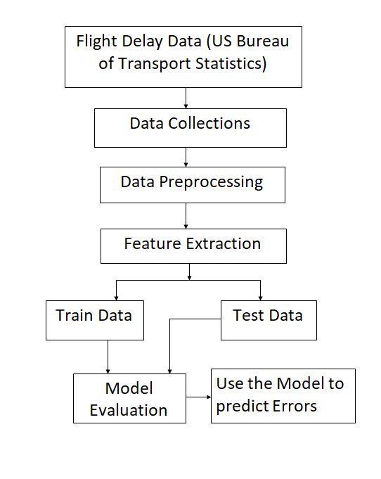
4.3 Flight delay prediction model:
Fig. Project Architecture

Slide 9
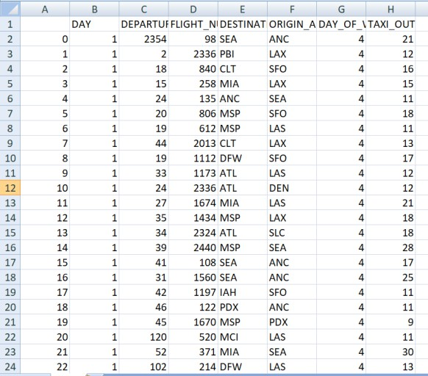
4.3.1 Flight Delay Data:
The dataset used for delay prediction consists of essential flight details, including departure times, airport locations, and operational conditions affecting schedules.
Critical parameters include flight number, departure time, departure and arrival airports, day of the week, and taxi-out duration.
By analyzing these factors, machine learning models can identify patterns linked to delays caused by congestion, weather conditions, and airport constraints.
4.3.2 Data Collection:
The dataset is compiled from the U.S. Bureau of Transportation Statistics and airline databases.
It includes flight schedules, departure and arrival details, airport-specific information, weather conditions, taxi-out durations, and historical delay records. This extensive dataset enhances delay pattern analysis and improves forecasting accuracy, supporting airlines and passengers in travel planning.

Slide 10
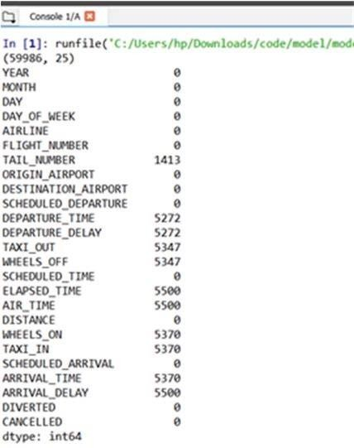
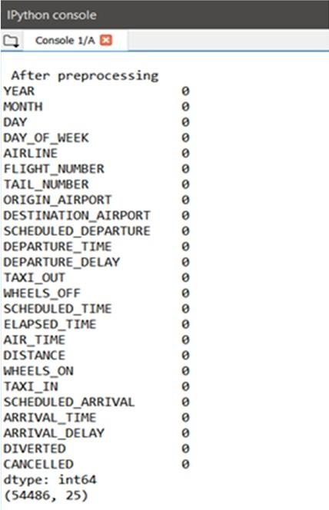
4.3.3 Data Preprocessing:
Prior to applying machine learning algorithms, preprocessing is performed to ensure data reliability.
The dataset, sourced from transportation records, consists of 13 attributes and nearly 60,000 records.
Missing values are addressed using Pandas' dropna() function to eliminate inconsistencies while preserving valuable information for model training.
Fig: 3.1.4.1: Before Data Preprocessing Fig: 3.1.4 .2: After Preprocessing
4.3.4 Train and Test Data Splitting:
To ensure effective model performance, the dataset is divided into an 80% training set and a 20% testing set using Scikit-learn’s train_test_split() function.

Slide 11




4.4 Model Evaluation
Once trained, the model is evaluated using:
Confusion matrix: The confusion matrix is a table that summarizes the performance of a classification model by comparing actual and predicted values
 | Actually Positive(1) | Actually Negative(0)
Predicted Positive(1) | True Positives (TPs) | False Positives (FPs)
Predicted Negative(0) | False Negatives (FNs) | True Negatives (TNs)
Accuracy metrics:
Accuracy: Represents the percentage of correctly predicted instance
Precision: Measures how many of the predicted positive cases were actually correct
Recall: Measures how many actual positive cases were correctly identified.
F1-Score: Balances precision and recall in a single metric

Slide 12
4.4 System Requirements:
1. Hardware Requirements:
System : Intel Core i7.
Hard Disk : 1TB.
Monitor : 15’’ LED
Input Devices : Keyboard, Mouse
Ram : 16GB.
2. Software Requirements:
Operating system : Windows 10.
Coding Language : Python
Tool : PyCharm, Visual Studio Code
Database : SQLite3

Slide 13
4.5 Advantages of Proposed System:
Utilizes supervised learning with scheduled and actual flight times.
Implements computationally efficient algorithms.
Predicts delays based on multiple influencing factors.
Employs models like Logistic Regression, Decision Tree Regressor, Random Forest, and Gradient Boosting Regressor for accuracy.
4.6 ALGORITHMS:
Logistic Regression: Predicts delay time based on factors like weather, departure time, and congestion.
Example: Estimating delay in minutes using wind speed and humidity.
Gradient Boosting: A boosting algorithm that sequentially refines weak learners to improve classification accuracy.

Slide 14
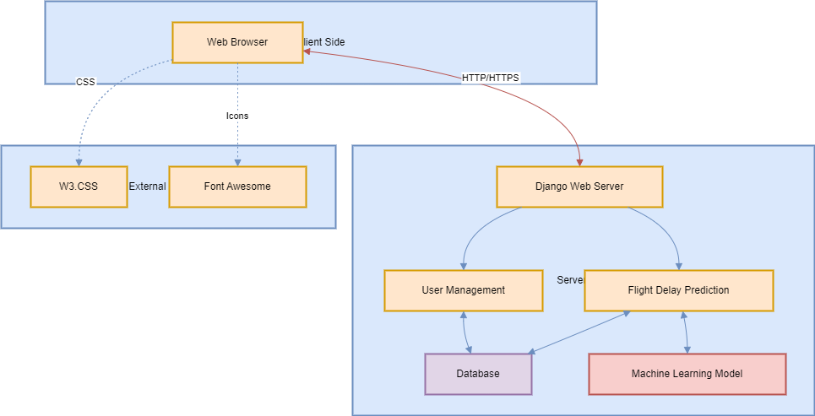
5. SYSTEM DESIGN:
5.1 SYSTEM ARCHITECTURE:

Slide 15
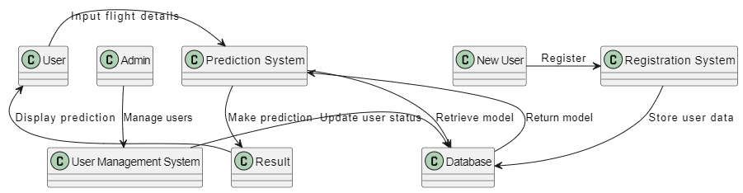
5.2 DATA FLOW DIAGRAM:
User Interaction & Registration:
New users register through the Registration System.
Registered users or admins can input flight details to check for possible delays.
Prediction Process:
The Prediction System retrieves the trained Machine Learning model from the Database.
It processes the flight details, performs prediction, and stores the result in the Result component.
Admin & Data Management:
The Admin manages users through the User Management System.
The Database stores all important data like user information, trained models, and prediction history for efficient system functioning.

Slide 16
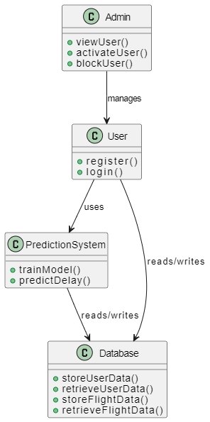
5.3 UML DIAGRAMS:
This component diagram represents a Flight Delay Prediction System where the Admin manages users, and Users interact with the system by registering, logging in, and using the Prediction System to predict flight delays. The Prediction System uses a trained model to perform predictions.
All user data and flight details are stored and retrieved from the Database. The Admin can view, activate, or block users, while the Prediction System reads and writes data (user and flight data) from/to the Database to generate accurate predictions.

Slide 17
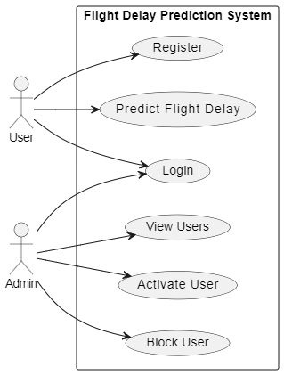
5.4 USE CASE DIAGRAM:
A use case diagram in the Unified Modeling Language (UML) is a type of behavioral diagram defined by and created from a Use-case analysis.
Its purpose is to present a graphical overview of the functionality provided by a system in terms of actors, their goals (represented as use cases), and any dependencies between those use cases.
The main purpose of a use case diagram is to show what system functions are performed for which actor. Roles of the actors in the system can be depicted.

Slide 18
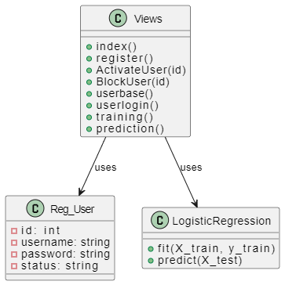
5.5 CLASS DIAGRAM:
In software engineering, a class diagram in the Unified Modeling Language (UML) is a type of static structure diagram that describes the structure of a system by showing the system's classes, their attributes, operations (or methods), and the relationships among the classes.
It explains which class contains information.

Slide 19
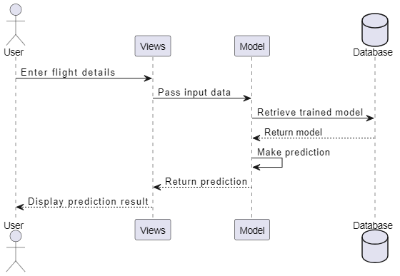
5.6 SEQUENCE DIAGRAM:
A sequence diagram in Unified Modeling Language (UML) is a kind of interaction diagram that shows how processes operate with one another and in what order.
It is a construct of a Message Sequence Chart. Sequence diagrams are sometimes called event diagrams, event scenarios, and timing diagrams.

Slide 20
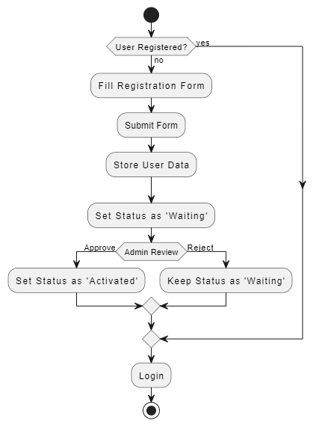
5.7 ACTIVITY DIAGRAM:
Activity diagrams are graphical representations of workflows of stepwise activities and actions with support for choice, iteration and concurrency.
In the Unified Modeling Language, activity diagrams can be used to describe the business and operational step-by-step workflows of components in a system. An activity diagram shows the overall flow of control.

Slide 21
6. TEST CASES:
Test Case No. | Test Scenario | Test Steps | Expected Outcome
1 | Valid Input Data | 1. Input valid data for all fields (e.g., FL_DATE, TAIL_NUM, CRS_DEP_TIME). | Form should submit successfully and display prediction result.
 |  | 2. Submit the form.
2 | Invalid Flight Date | 1. Input an invalid or future date for FL_DATE. | The form should reject submission and show an error message like "Invalid date."
 |  | 2. Submit the form.
3 | Missing Required Fields | 1. Leave some required fields (e.g., OP_UNIQUE_CARRIER) blank. | Error messages should indicate missing fields, and no prediction is made.
 |  | 2. Submit the form.
4 | Predicting for Cancelled Flight | 1. Set CANCELLED to 1. | The system should display a message like "Flight is canceled," and no prediction is made.
 |  | 2. Fill other fields with valid data.
 |  | 3. Submit the form.
5 | Invalid Airport ID | 1. Input invalid data for ORIGIN_AIRPORT_ID or DEST_AIRPORT_ID. | Error message should display "Invalid Airport ID."
 |  | 2. Submit the form.
6 | Valid Flight Number Format | 1. Input a valid numeric flight number in OP_CARRIER_FL_NUM. | Form should submit successfully, and a prediction should be displayed.
 |  | 2. Submit the form.

Slide 22
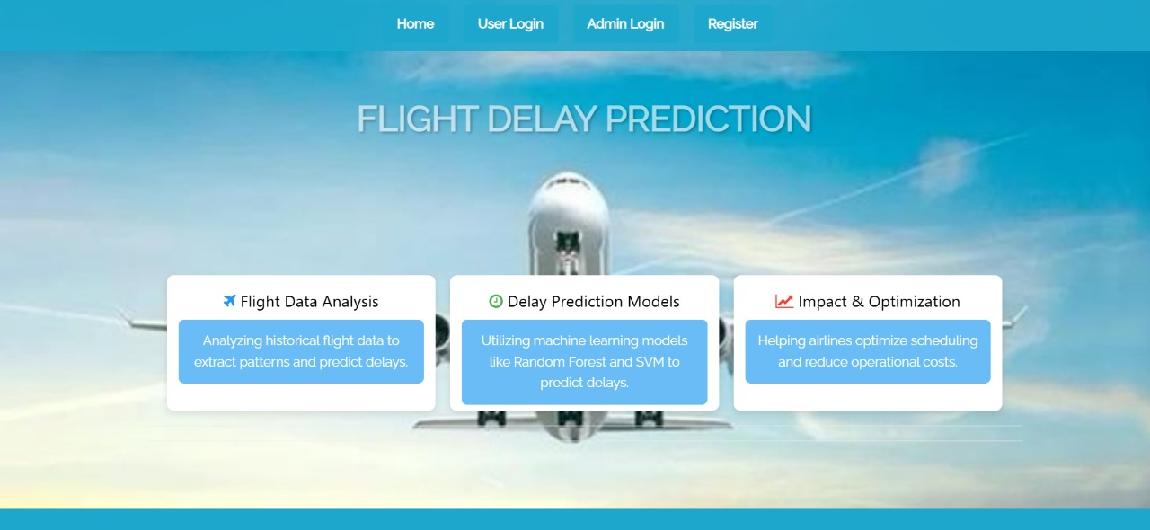
7. RESULTS:
Fig. Home Page

Slide 23
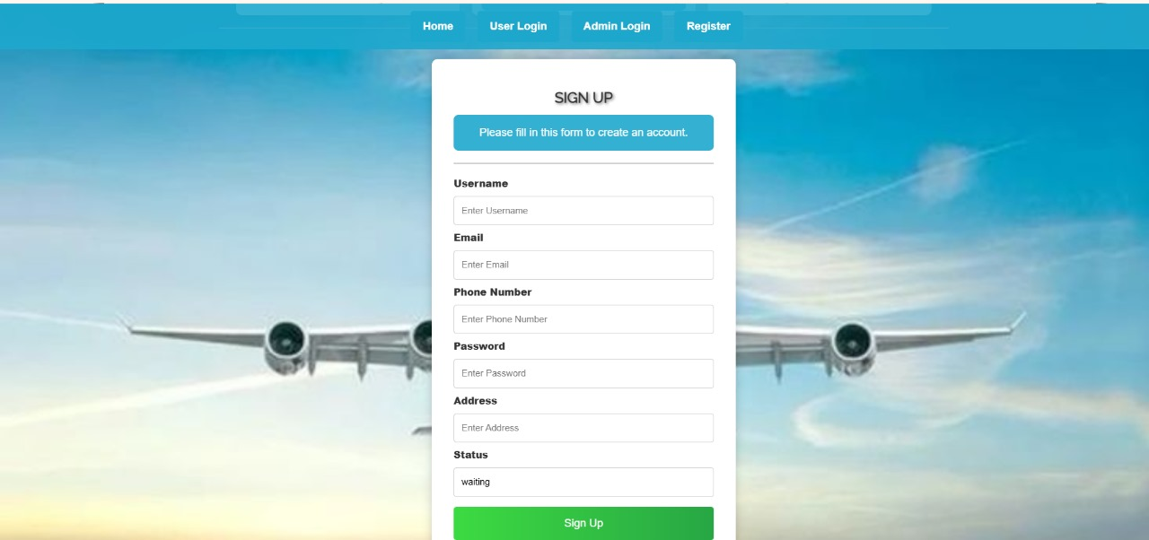
Fig. User Registration Page

Slide 24
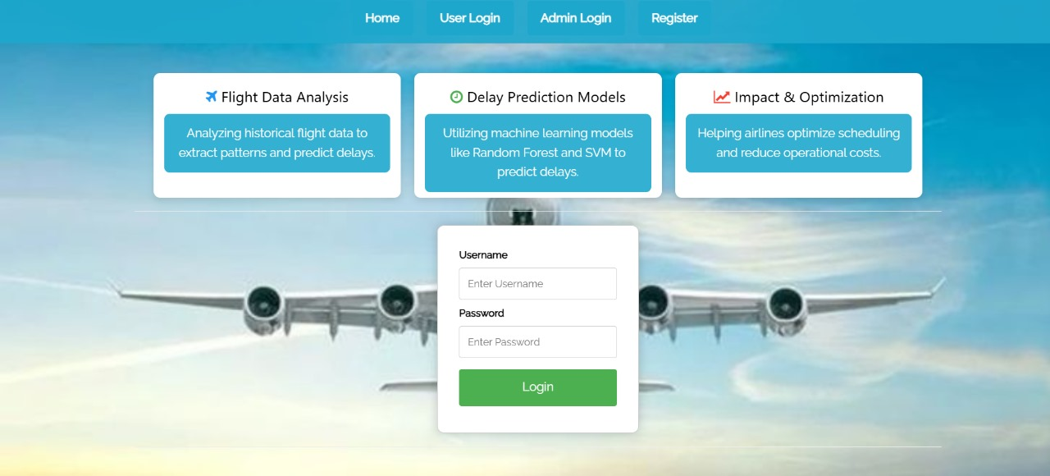
Fig. User Login Page

Slide 25
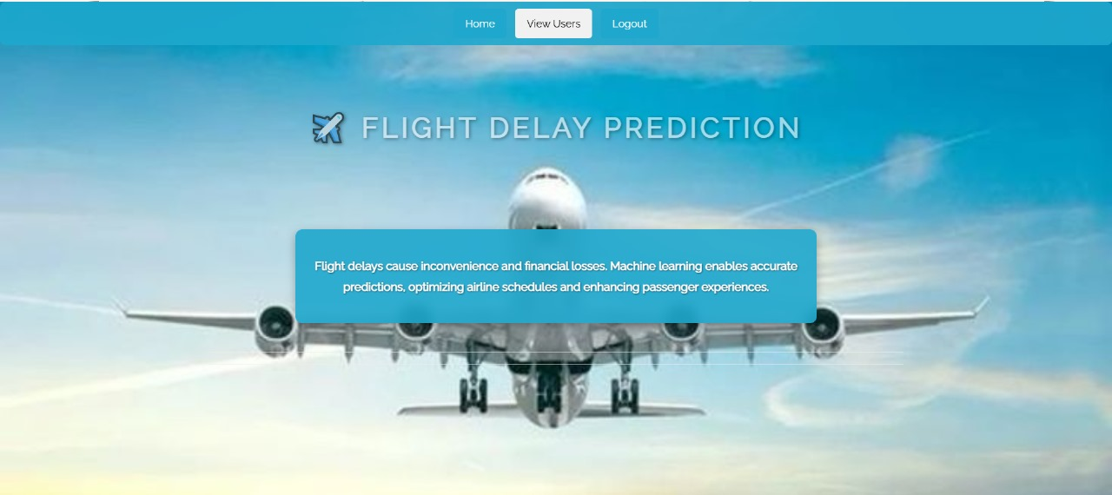
Fig. Admin Home Page

Slide 26

Fig. User Home Page

Slide 27

Fig. Training Result Page

Slide 28
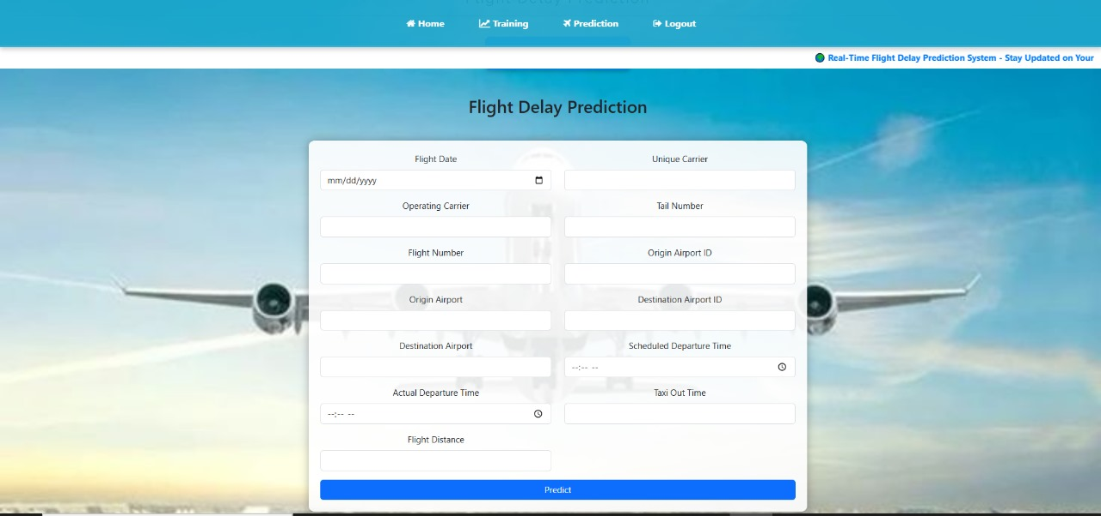
Fig. Flight Delay Prediction Page

Slide 29
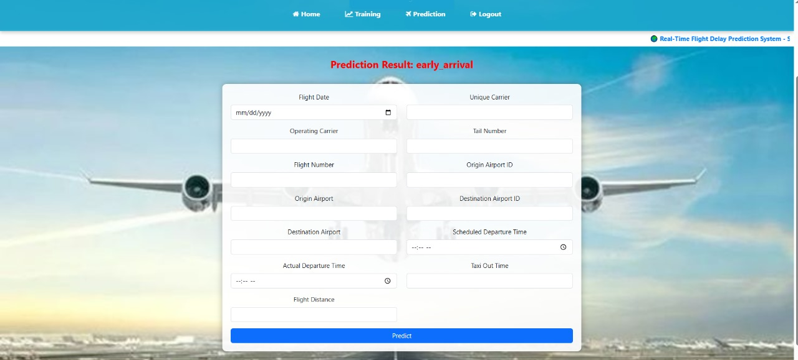
Fig: Prediction Result

Slide 30
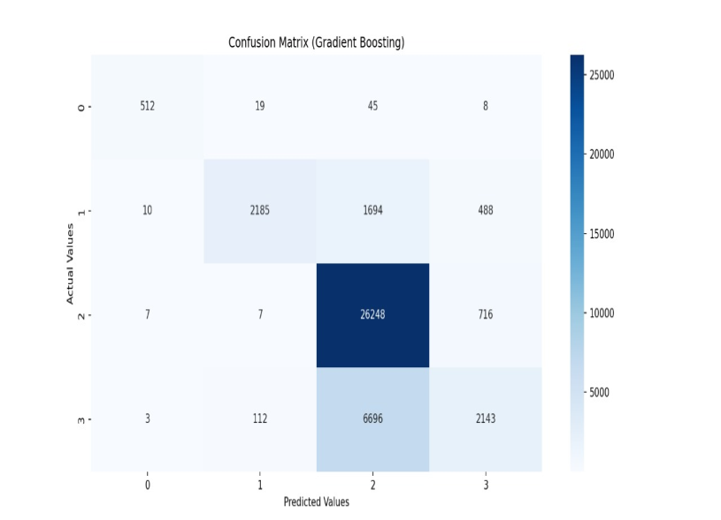
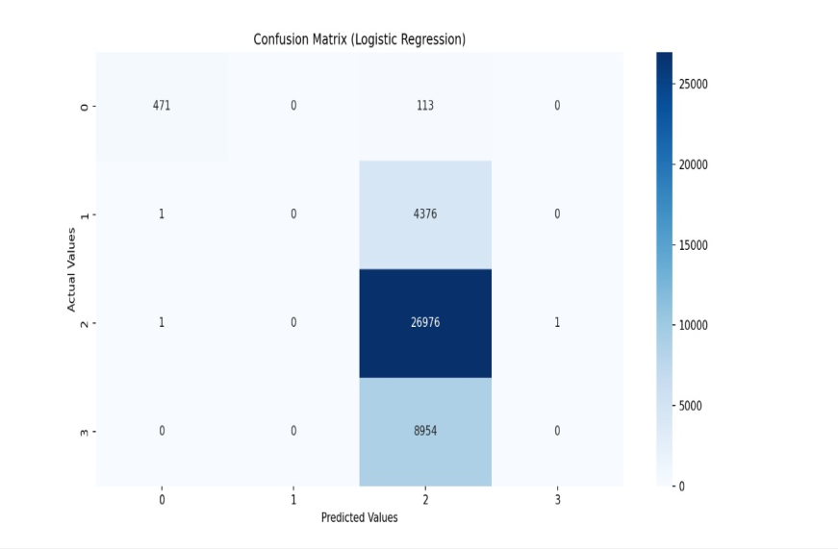
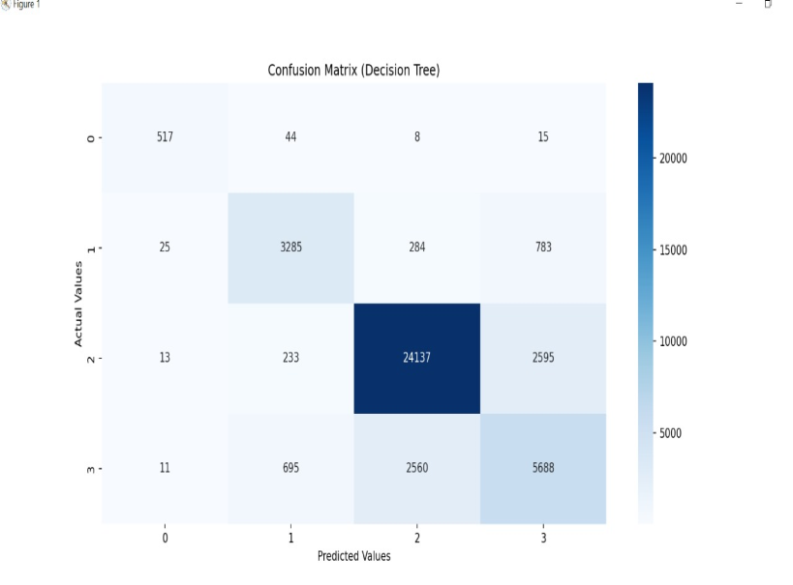
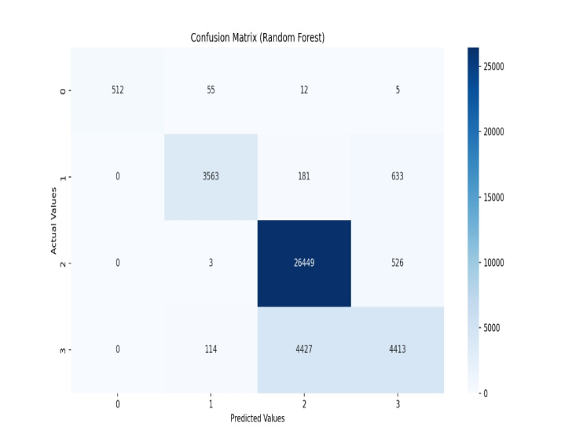
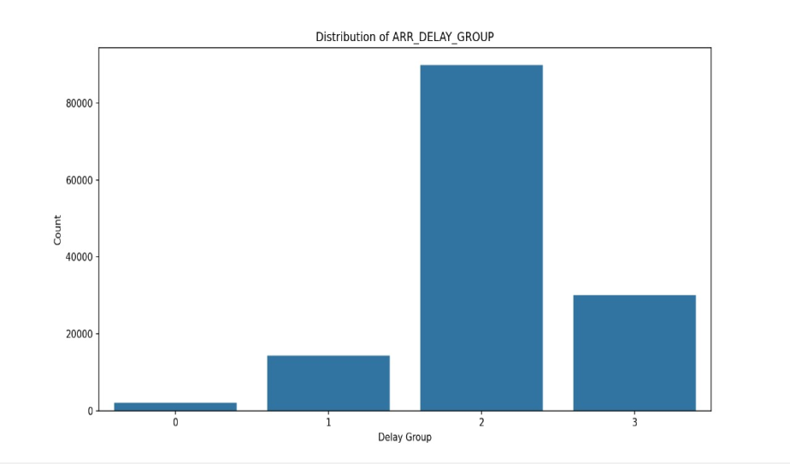
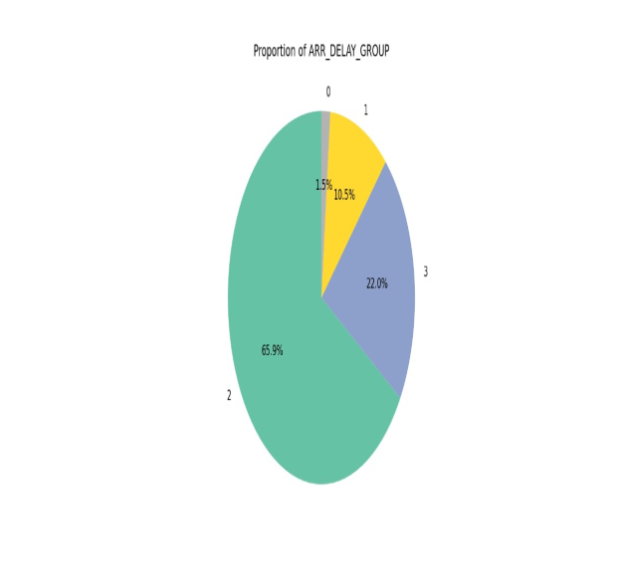
Graphs:

Slide 31
8. CONCLUSION:
Our research showed that aircraft delay predictions may be made with good accuracy using machine learning methods. In addition to evaluating delays for different human requirements, the previously mentioned categorization and analysis aims to closely examine elements that impact delays, including ‘weather delay,’ ‘airline delay,’ and ‘security delay’.
The Gradient Boosting model performed the best, correctly categorizing delays into two groups using the previously mentioned parameters including ‘Departure Time’ ,‘Air Time’, and ‘Month’—with 90% accuracy. Thus, it can be effectively used to predict flight delays, which will be beneficial for airports and airlines, as well as passengers.
Therefore, the study of flight delays presented in this paper is grounded entirely in scientific parameters, underscoring its crucial significance in the aviation industry.

Slide 32
FUTURE ENHANCEMENT:
Explore Additional Machine Learning Algorithms
The paper you uploaded also explores CNN-LSTM deep learning frameworks for improving delay predictions. These models capture sequential data better, which could be helpful if you have time-series data or patterns​(Flight Delay_Prediction).
Feature Engineering
Time-based features: Incorporate features such as the day of the week, month, or time of the day to improve the accuracy of the predictions. Flight delay data often has time-based patterns.
. Visualization and Interpretability
Add more advanced visualizations such as ROC Curves, Precision-Recall curves, and Feature Importance charts.
For interpretability, you could integrate methods like SHAP (SHapley Additive exPlanations) to explain feature contributions

Slide 33
THANK YOU

